Slide 1


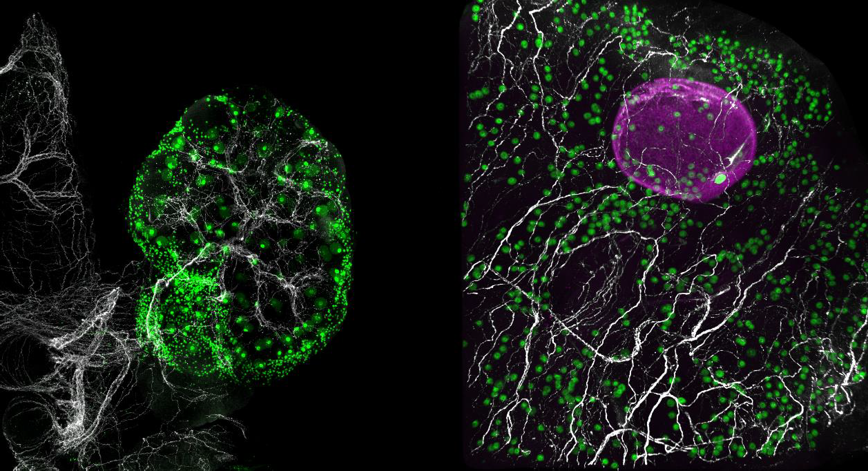
Mapping Ovarian Aging: A Landmark Cross-species Atlas
January 15, 2026
A recent study published in Science by Diana Laird and her BARI team presents the most comprehensive single-cell atlas of aging ovaries in humans and mice to date. The ovary stands out as the fastest-aging organ in the body: in humans, fertility declines markedly earlier than the functional decline of other organs, and individuals who become pregnant at age 35 or older are classified as being of advanced maternal age. To unravel this accelerated process and identify potential mechanisms for future interventions, it is essential to determine which features of ovarian biology are conserved between mice – the premier model organism – and humans, and where key divergences occur. This work represents a major advance in reproductive biology, delivering high-resolution, cross-species insight into ovarian aging.
The ovary coordinates reproduction with notable species differences
The ovary serves as the central regulator of female reproduction, orchestrating dynamic interactions between germline cells (oocytes) and the surrounding somatic cells to generate mature oocytes and secrete hormones that govern fertility, pregnancy, and aspects of aging. In both humans and mice, females are born with a fixed, non-renewable pool of immature oocytes that become encapsulated by somatic cells to form the primordial follicle reserve – a lifetime supply that cannot be replenished. Small groups of these resting/quiescent primordial follicles activate and progress through
conserved developmental stages (primary, secondary, tertiary/antral, and pre-ovulatory). During this progression, supporting somatic cells (granulosa and theca cells) produce hormones, but from the tertiary stage onward, the process is predominantly
controlled culminating
by systemic hormones, in ovulation and the
formation of the corpus luteum to support early pregnancy.
A mouse ovary (left) and a fragment of a human ovary (right). Sympathetic nerves (white) grow alongside the eggs (green). A large growing follicle containing an egg is shown in magenta on the right.
While the cellular and molecular basics of folliculogenesis are remarkably similar across species, important functional differences exist: humans are typically mono-ovulatory (releasing one egg per cycle, leading to single pregnancies), whereas mice are multi-ovulatory (releasing multiple eggs and producing litters of 2-12 pups). In women, reproductive capacity drops noticeably after age 35 on average, with menopause arriving around age 50, when menstrual cycles cease. Mice do not experience true menopause but mirror key aspects of human reproductive aging on a much faster timeline – mice at 2-4 months resemble women in their early 20s, while those at 9-12 months model human ovarian aging in the late 30s to mid-40s. This accelerated pattern makes mice exceptionally valuable models for studying

Slide 2
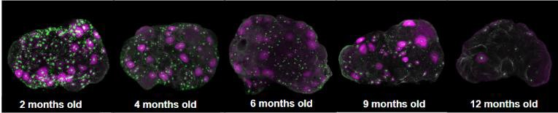
human fertility and ovarian aging, though challenges remain in directly comparing single-cell RNA sequencing data across species due to differences in cell type annotations, particularly in the supportive microenvironment around follicles. Bridging these gaps could accelerate the translation of mouse findings into therapies for preserving human fertility and ovarian health.
Distinct spatial organization of the aging ovary in mice and humans
To enable three-dimensional mapping of asynchronous folliculogenesis in intact ovaries, the team developed a custom whole-mount immunostaining and tissue-clearing protocol. This innovative approach allowed detailed analysis of follicle dynamics in mice aged 2 to 12 months (corresponding to human reproductive stages from early 20s to mid-40s) and in large pieces of human ovaries from young and advanced reproductive age donors. In mice, primordial follicle numbers declined gradually until around 9 months, followed by a
steeper months. follicle
drop by 12
Growing counts relatively
remained
stable until 6 months
An age-dependent decline in the number of eggs (green) and the subset of growing follicles (magenta) quantified in the entire ovary, shown in a mouse at 2 months (left) and 12 months of age (right).
before declining
markedly by 9
months, while secondary follicle loss was detectable as early as 4 months. Oocyte density began decreasing around 4 months, dying follicles remained similar until 12 months, and total follicle numbers held steady until 9 months, indicating a breakdown in follicular homeostasis around 9 months.
In humans, age-related oocyte loss and reduced relative oocyte density paralleled the mouse patterns, yet the spatial architecture diverged sharply. Mouse ovaries maintained a fairly uniform distribution of oocytes throughout the tissue at all ages, whereas aging human ovaries developed isolated, oocyte-rich cortical “pockets” separated by large follicle-free regions. These pockets became relatively smaller with advancing age, highlighting shared features of reproductive aging, such as oocyte depletion and density reduction, and species-specific differences in follicle distribution that may influence how ovarian reserve is maintained or lost over time.
A cross-species comparison of the ovarian cell subtypes
Using single-cell RNA sequencing (scRNA-seq), Laird and team performed high-resolution subclustering to identify distinct subtypes within major ovarian cell populations, including granulosa (egg-supporting), luteal, immune, theca, fibroblast (structural support), epithelial, smooth muscle, pericyte (vascular), endothelial (vessel), and glial cells. While subtypes in granulosa, fibroblast, and endothelial compartments were largely conserved across species, clear divergences emerged in theca, pericyte, and epithelial populations, likely reflecting differences in ovary size, follicle density, and overall structure. Notably, granulosa cells comprised four shared subtypes, with a fifth mouse-specific subtype marked by growth hormone receptor. Further analysis suggested this group represents a temporary, hormonally responsive maturation state.

Slide 3

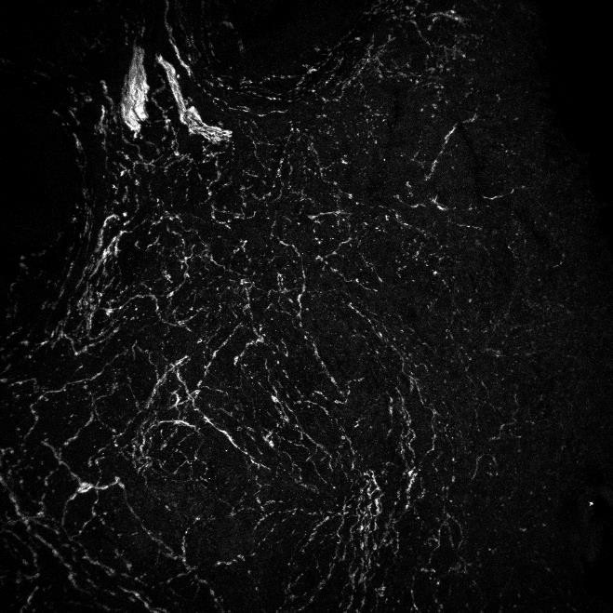
Immune cells also revealed shared subtypes (like macrophages, neutrophils, and certain T cells) alongside mouse-exclusive ones (such as natural killer cells and specific T cell varieties), possibly reflecting differences in immune balance between species. Theca and fibroblast subtypes supported follicle growth and structure but displayed species-specific functions, including unique roles in immune signaling, tissue remodeling, and hormone metabolism in mice versus humans. Vascular cells (endothelial and pericytes) showed both conserved pathways for follicle development and some specialized features, like nerve-related growth in certain groups. Mouse epithelial cells were homogenous while human epithelial cells showed transcriptional diversity. Luteal (post-ovulation) subtypes were not compared directly due to the inability to capture them in human samples.
Conserved sympathetic nerves and glia shape folliculogenesis and aging
Although peripheral nerves have long been known to influence organ function, their role in the ovary has received little attention until recently. This study identified a conserved population of glia in mouse and human ovaries that are closely linked to sympathetic
nerves (part of the “fight or flight” system), which form dense
The density of sympathetic nerves (white) increases with age in the human ovary, shown in 3D images at 23 (left) and 55 years (right).
branched networks throughout the
ovary. The nerves and glia emerge early in development, by embryonic day 16.5 in mice and around 8 weeks post-conception in humans, and expand outward with age. Pericytes that wrap blood vessels produce nerve growth factor, helping maintain these nerves, while theca cells express guidance cues and receptors that may modulate neurotransmitter signaling.
A key functional insight came from genetically ablating sympathetic nerves in mice (using TrkA knockout in TH+ cells), which resulted in more primordial (reserve) follicles but significantly fewer growing and large antral follicles, indicating that sympathetic innervation promotes follicle recruitment and maturation during the initial wave of folliculogenesis. With aging, sympathetic axon density increases in both species (likely due to declining estrogen, which normally dampens innervation), alongside shifts in the ovarian microenvironment: theca cells show the greatest age-related transcriptional changes in mice, while fibroblasts and endothelia are most affected in humans, likely underlying the onset of fibrosis and vascular decline. These conserved, yet species-specific, patterns suggest sympathetic nerves and glia play an active role in follicle dynamics and reproductive aging, opening new avenues for understanding fertility decline and common conditions like polycystic ovarian syndrome (PCOS).
Transcriptomic shifts driving fertility decline
The decline in fertility observed with age is driven by a loss of oocyte quality and quantity, as shown by clinical data from in vitro fertilization (IVF). In detailed IVF experiments in mice

Slide 4
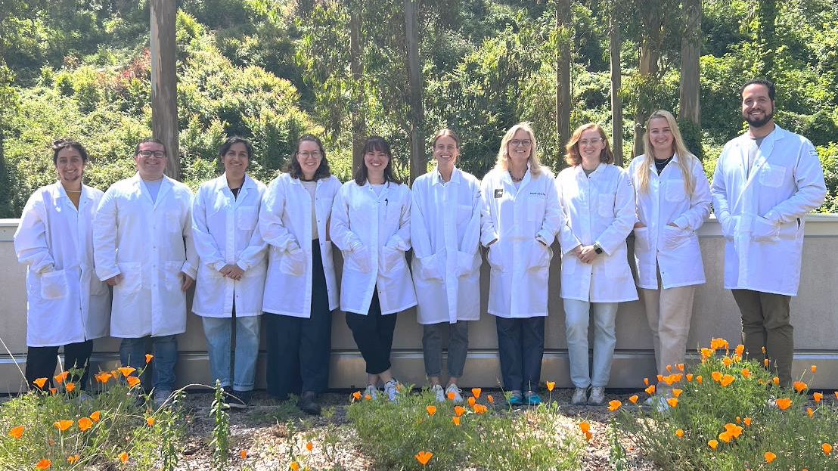
across reproductive ages (2-12 months), oocyte yield dropped sharply by 9 months (aligning with reduced growing follicles), but hormone responsiveness held until 12 months.
The capture of oocytes in single-cell transcriptomic datasets has eluded the field owing to their large size and fragility. Since growing oocytes don’t fit in microfluidics devices, the team hand-dissected them from follicles and made single-cell libraries in collaboration with the San Francisco CZ Biohub. This revealed greater age-dependent transcriptional shifts in oocytes than in supporting granulosa cells, with mouse early-stage oocytes and human late-stage oocytes exhibiting the largest changes. Species-specific differences also emerged: mouse early oocytes showed declining zona pellucida genes (affecting structure and sperm binding), while human late oocytes displayed reduced chromosome segregation genes and increased DNA damage response genes. Pathway analysis highlighted conserved aging features (inflammation and ROS) alongside divergences, such as upregulated protein ubiquitination/TOR signaling in mouse early oocytes and spindle/chromatin pathways in human late oocytes which have been implicated in aneuploidy.
Cell-cell communication analysis (via CellChat) further illuminated age-related disruptions in follicle maturation. Granulosa-to-oocyte signaling also showed conserved pathways and species-specific shifts. Theca-to-granulosa crosstalk maintained stable testosterone/ androstenedione in mice but became early reproductive age-specific in humans, alongside conserved age-related drops in cholesterol signaling. These findings underscore that while oocyte-intrinsic deterioration drives fertility loss, altered somatic support – particularly in granulosa and theca cells – may contribute via species-divergent endocrine and signaling changes, with implications for understanding perimenopausal testosterone decline and its broader health effects.
What’s next for the Laird lab?
A major goal of the Laird lab is to ask whether it is possible to modulate or even reverse aging of the ovary in any respect. “Though we cannot generate new eggs, we can hope to stem the rate of loss over time” says Diana. This new understanding of the mechanisms of communication and support of ovarian follicles from
other ovarian cell types (such as sympathetic nerves) makes the identification of rejuvenation targets more likely. In follow-on studies of interventions and genetic mouse mutants, this comparative atlas of normal aging will serve as a benchmark for determining conditions and cell types that can alter ovarian aging. Finally, the team is applying their knowledge of normal and perturbed ovarian aging to identify blood biomarkers of remaining fertility and menopause in people.

